Slide 1
Database system
Saba Ghani
FAST-NU
Chiniot Faisalabad Campus

Slide 2
DCL
The SQL security scheme is based on three central concepts
Users.
The actor in the database. Each time they retrieves, inserts, delete or update data.
Database Objects.
The items to which SQL security protection can be applied. These objects are tables and views.
Privileges:
The action that a user is permitted to carry out for a given database object. These privileges are SELECT, INSERT, DELETE AND UPDATE.
To established a security scheme for a database, you use the SLQ GRANT statement to specify which user have which privileges on which database object.

Slide 3
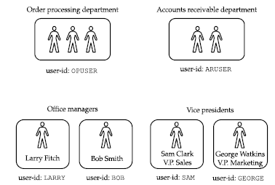
USER ID
Each user of a SQL-based database is typically assigned a user-id, to identify the user to the DBMS software.
User-id determine whether the statement will be permitted or prohibited by the DBMs.
Assigned by DBA.
Creating user syntax
Create user username identified by password;
Create user sam identified by welcome123;

Slide 4
Group of users
BUNDLE OF PRIVILIGES TO MANY USERS → USE ROLE
Role define set of privileges.
Grant create session, create user, create table, insert, delete on table name to role name;
Grant select delete update on table name to r1;
Assigned these grants to new user Grant r1 to user1,user2,user3,user4….,usern;
If a group of user perform same task then we create role for group of users.
Suppose Sam, David, Jerry are clerk so we create role for them
Create role clerk identified by login;

Slide 5
Group of users
Now grant this clerks role to users like this
grant clerk to sami, scott, ashi, tanya ;
Now Sami, Scott, Ashi and Tanya have all the privileges granted on clerks role.
Suppose after one month you want grant delete on privilege on emp table for all these users then just delete these privilege to clerks role and automatically all the users will have the privilege.
grant delete on emp to clerks;
If you want to take back update privilege on emp table from these users just take it back from clerks role.
revoke update on emp from clerks;
To Drop a role
Drop role clerks;
To modify role use ALTER command.
Alter role role name with attribute name;
Alter role clerk with system_clerk;

Slide 6
SQL Session
An SQL session is the connection between some sort of client application and the database.
The session provides the context in which the authorization identifier executes SQL statements during a single connection.
The session begins when you start the interactive SQL program, and it lasts until you exit the program.
In an application program using programmatic SQL, All of the SQL statements used during the session are associated with the user-id specified for the session.
Usually, you must supply both a user-id and an associated password at the beginning of a session.
Grant create session to sam;
Notes:
ALTER SYSTEM SET RESOURCE_LIMIT = TRUE;

Slide 7
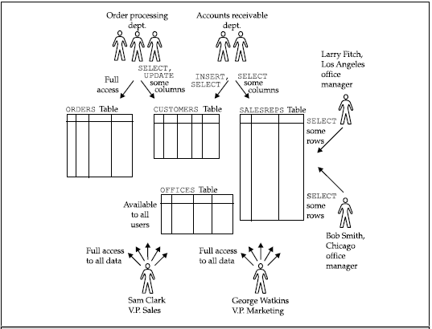
GRANT the Privileges
For example, here is a GRANT statement that lets Sam Clark retrieve and insert data in the OFFICES table of the sample database:
GRANT SELECT, INSERT
ON OFFICES
TO SAM

Slide 8
GRANT statement
SQL GRANT is a command used to provide access or privileges on the database objects to the users.
Normally, the GRANT statement is used by the owner of a table or view to give other users access to the data.
GRANT SELECT, INSERT, DELETE, UPDATE
ON OREDER
TO OPUSER
Allow Sam Clark to insert or delete an office.
GRANT INSERT, DELETE
ON OFFICES
TO SAM

Slide 9
GRANT STATEMENT
Assign all privileges to the user using ALL PRIVILEGES statements
GRANT ALL PRIVILEGES
ON SALESREPS
TO SAM
Give all users SELECT access to the OFFICES table.
GRANT SELECT
ON OFFICES
TO PUBLIC
Let order-processing users change company names and customer repository
GRANT UPDATE (COMPANY, CUST_REP)
ON CUSTOMERS
TO OPUSER

Slide 10
Give accounts receivable users read-only access to the employee number, name, and sales office columns of the SALESREPS table.
GRANT SELECT (EMPL_NUM, NAME, SALES_OFFICE)
ON SALESREPS
TO ARUSER
Passing GRANT
GRANT SELECT
ON WESTREPS
TO LARRY
WITH GRANT OPTION
Larry can now issue this GRANT statement:
GRANT SELECT
ON WESTREPS
TO SUE

Slide 11
REVOKE
The privileges that you have granted with the GRANT statement can be taken away with the REVOKE statement
A REVOKE statement may take away all or some of the privileges that you previously granted to a user-id.
Grant and then revoke some SALESREPS table privileges.
GRANT SELECT, INSERT, UPDATE
ON SALESREPS
TO ARUSER, OPUSER
REVOKE INSERT, UPDATE
ON SALESREPS
FROM OPUSER

Slide 12
Take away UPDATE and DELETE privileges for two user-ids.
REVOKE UPDATE, DELETE
ON OFFICES
FROM ARUSER, OPUSER
Take away all privileges on the OFFICES that were formerly granted to all users.
REVOKE ALL PRIVILEGES
ON OFFICES
FROM PUBLIC

